Slide 1

Communications PMBOK, 6th Ed., 2017 – Unless Otherwise Noted Includes an introduction to metrics driven SMART Goal implementation Unless otherwise noted, all pictures are from ClipArt.com

Slide 2

Why ”communications” is important (p. 61 PMBOK 6th ed)
“research shows that top project managers spend about 90% of their time on a project in communication”

Slide 3
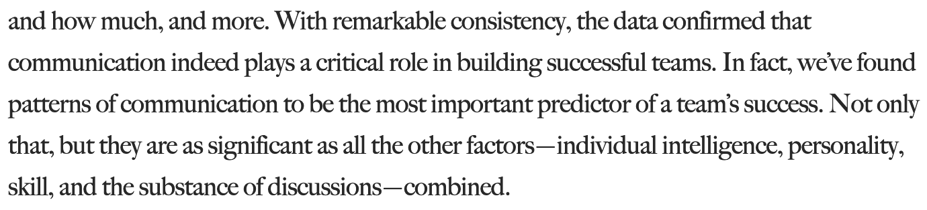
Information from the Harvard Business Review on an MIT Study
https://hbr.org/2012/04/the-new-science-of-building-great-teams

Slide 4
Information from the Harvard Business Review on an MIT Study
…Successful teams share several defining characteristics:
Everyone on team talks and listens in roughly equal measure; keeping contributions short and concise
Members face one and other and their conversations and gestures are energetic.
Members connect directly with one another; not just the team leader
Members have direct communication with each other
Members periodically go exploring outside of their team and bring back information
https://hbr.org/2012/04/the-new-science-of-building-great-teams

Slide 5

Project Communications Management (p. 359)
“….includes the processes necessary to ensure that the information needs of the project and its stakeholders are met through development of artifacts and implementation of activities designed to achieve effective information exchange.”

Slide 6
Communication plans need to be updated as appropriate.

Slide 7

Types of concepts for Communications Management (p.360)
Written
Spoken
Formal or informal
Through gestures
Through media
Choice of words

Slide 8

Communication Defined (dictionary.com #3)
Something imparted, interchanged, or transmitted
Communications should also include the expectation that the receiver understands the message in the way the sender intended. (bv)

Slide 9

Communication Activities (p. 361)
Internal
External
Formal
Informal
Hierarchical focus (up, down, lateral)
Unofficial
Written and oral

Slide 10
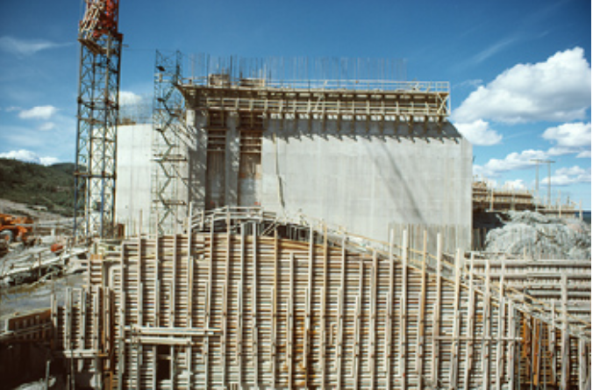
There are 2 parts to successful communication
(p. 362) Developing an appropriate communication. Based on:
Project needs
Stakeholder’s needs
(p. 359) Carrying out the activities necessary to implement the communication strategy

Slide 11

Communication Trends (p. 364)
Inclusion of stakeholders in project reviews
Inclusion of stakeholders in project meetings
Increased use of social computing
Multifaceted approaches to communication
Embraces & selects from all technologies and respects
Cultural
Practical
Personal preferences(Language, media, content and delivery)
https://www.pinterest.co.uk/pin/556757572656301062/

Slide 12
Plan Communications Management 10.1

Slide 13

Plan Communications Management defined…
“…the process of developing an appropriate approach and plan for project communications activities based on the information needs of each stakeholder or group, available organizational assets, and the needs of the project.” (p. 366)

Slide 14

Communications plans are to ….
1
… be reviewed regularly. (p. 367)

Slide 15

When communication planning is started…
1
…Early in the project (p. 367)

Slide 16

Communication Plan Inputs (p. 368)
Project charter
Project management plan
Project documents
Requirements documentation
Stakeholder register
Enterprise environmental factors
Stakeholder risk thresholds
Geographic distribution of facilities and resources
Etc.

Slide 17

Plan Communication T&T (p. 369)
Expert judgement/Stakeholders, especially customers and sponsors
Communication Requirement Analysis plan

Slide 18

Selection of Technology (p. 369-370)
Urgency
Reliability of channel
Ease of use
Sensitivity
Need for persistent documentation (bv)

Slide 19
Communication Models (p. 371) “Simple basic sender/receiver communication model”
Encode
Decode
Transmit over a channel
(“noise” distorts the message sometimes)

Slide 20
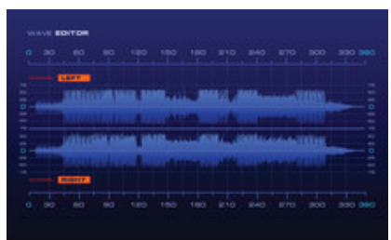
Communication Models (p. 372) “Sample interactive communication model”
Acknowledge
Feedback
Definition “noise”= “…any interference or barriers that might compromise the understanding of the message, such as distraction of the receiver, variations in the perceptions of receivers, or lack of the appropriate knowledge or interest.”

Slide 21

The sender is responsible for: (p. 372)
Picking the right channel (bv)
Transmission of the message
Ensuring the information being communicated is clear and complete
Confirming the message is correctly interpreted

Slide 22

Cross-cultural communication (p. 373)
Age
Nationality
Professional discipline
Ethnicity
Gender
Accent (bv)

Slide 23

Communication Methods (p. 374)
Interactive (e.g. real time face-to-face one-on-one conversation)
Push (like an e-mail that is sent out that no one can reply to)
Pull (like e-learning)

Slide 24

Communication Plans Output – Communications Management Plan (p. 377)
Communication requirements
Frequency of communications
Glossary of terms
Etc. (other types, guidelines & templates)

Slide 25
Manage Communications 10.2

Slide 26

Manage Communications defined…(p. 379)
“… the process of ensuring timely and appropriate collection, creation, distribution, storage, retrieval, management, monitoring, and the ultimate disposition of project information.”

Slide 27

Cool project documents (p. 382)
Change log
Issues log
Lessons learned register
Risk report
Describes overall project risk
Summary information on identified individual risks
Communicated to interested stakeholders
Stakeholder Register

Slide 28

Work Performance Reports (p. 382) These support decision making processes and monitoring and controlling.
Dashboards (visually displays key performance indicators, in an easy to quickly understand/easily-usable way - bv)
Heat reports (a.k.a. “heat maps” - bv …. https://bit.ly/2TQm6WE)
Stop light charts (https://bit.ly/2GE9vSC *)
* One cool use of heat charts I have heard of is tracking where customer’s eyes look when they are viewing
products on a store shelf. This lets marketing people know if their product’s packaging stand out. Also these can be used by web developers, in a similar way, to see how eyes respond to a screen’s design.
** This is an isixsigma.com publication. This is a known repository of six sigma knowledge. Please see example #2. (bv)

Slide 29
Metrics (bv)
Metrics a just a measurement, with no independent specific business value, without context. For example, if I told you your website sold $1,245 in widgets yesterday, is that good news, or, bad news? Given that $1,245 has no context, the $1,245 is a useless number.
SMART Goals assign meaning to metrics. You can then know if you are on target, and if not, your metrics will indicate that (based on your goal), and can then assist you to understanding if you are getting better as you try to improve.
Caution: Metrics and goals will drive specific behaviors. Typically desired behaviors. But not always; please see the next slide.

Slide 30

Main Idea…
1
…“If you can measure it, you can manage it.”
Source of quote: Anonymous

Slide 31

Metrics Driven Process Improvement Implementation(bv)
Establish measurement.
What do you want to measure?
What can you measure?
What is the potential cost/benefit of each measurement?
Carefully select the most valuable subset
Implement measuring procedures
Establish SMART Goals
Track for a reasonable amount of time (or, if possible use historical data) to understand what is currently happening
Establish SMART goals based on business expectations and current environment
Fix it
PDCA, driven by metrics and SMART goals
Redo PDCA until value of further improvement is not warranted.

Slide 32
Only Apply SMART Goals When…(bv)
People understand the importance to the business
People have the resources and authority to manage business processes and functions that impact SMART goal related metrics (huge issue)
Stakeholders who can positively impact ability for SMART goals to be:
Educated to understand the importance of meeting established SMART Goals
Can be incented to achieve SMART goal targets
SMART goals can be monitored and updated as time goes on to ensure they remain effective and drive efficient behaviors
Conditions related to achieved SMART goals are monitored as time passes to ensure that conditions do not deteriorate.

Slide 33
Metrics can drive bad behavior(bv)
1
Situation: I had a friend once, who who worked for a globally known and highly respected delivery company. He was in charge of 5 delivery trucks. Each truck driver had clearly stated goals for when all the packages in their trucks needed to be delivered by. My friend told me he had an issue one day when one of the trucks he was responsible for broke down.
Bad Behavior: None of the other 4 drivers, when asked, came to assist with the stranded packages. This was because the other 4 drivers knew that if they left their route, they would not make their delivery goals, and would therefore lose their monthly cash performance-incentive
Lesson Learned: Metrics based goals need to be created in a way that they are adaptive (a.k.a can be changed or altered in unusual situations) to allow for situations like this.

Slide 34
Metrics can drive unethical behaviors, especially in sales(bv)
Distribution of defective products to make “sales goals”
In the financial industry, alleged giving services to people they did not ask for “Wells Fargo (WFC) now says it has found a total of up to 3.5 million potentially fake bank and credit card accounts” https://cnnmon.ie/2MKb2FR)
5,300 Wells Fargo employees fired over 2 million phony accounts: https://money.cnn.com/2016/09/08/investing/wells-fargo-created-phony-accounts-bank-fees/index.html
Stop watching at 3:21 (1.3 M views)… https://www.youtube.com/watch?v=xJhkX74D10M
Wells Fargo we’ve fixed it video commercial (1 minute/2018): youtube.com/watch?v=qxExqOiCkPU&ab_channel=SpeakingHuman

Slide 35

Key Communication Skills (pp. 384 - 385)
Feedback
Non-verbal
Presentations
Social media
Placement (bv)
Damage control (bv)

Slide 36

Interpersonal & Team Skills – Huge! (p. 386)
Active listening
Conflict management
Cultural awareness
Meeting management
Networking
Political awareness

Slide 37
Monitor Communications 10.3

Slide 38

Monitoring Communications Defined
Defined: “… the process of ensuring the information needs of the project and its stakeholders are met.” (p. 388)
Value: “…determines if the planned communications artifacts have had the desired effect of increasing or maintaining stakeholder’s support for the project’s deliverables and expected outcomes.” (p. 389)

Slide 39
Need
You need to make sure the intended audience is getting the message in the intended way (p 389)

Slide 40

Monitoring Communications – how (p. 389)
Surveys
Lessons learned/retrospectives
Team observations
Reviewing the issues log
Stakeholder feedback

Slide 41
Project Management Plan Updates (p. 393)
A change control process should be used when updating the communication plan, inside the project management plan.
Communications management plan: updated with information to make new information communications more effective.
Stakeholder engagement plan:
Communication needs
Why they are important to the project

Slide 42
General Topics on Communication

Slide 43
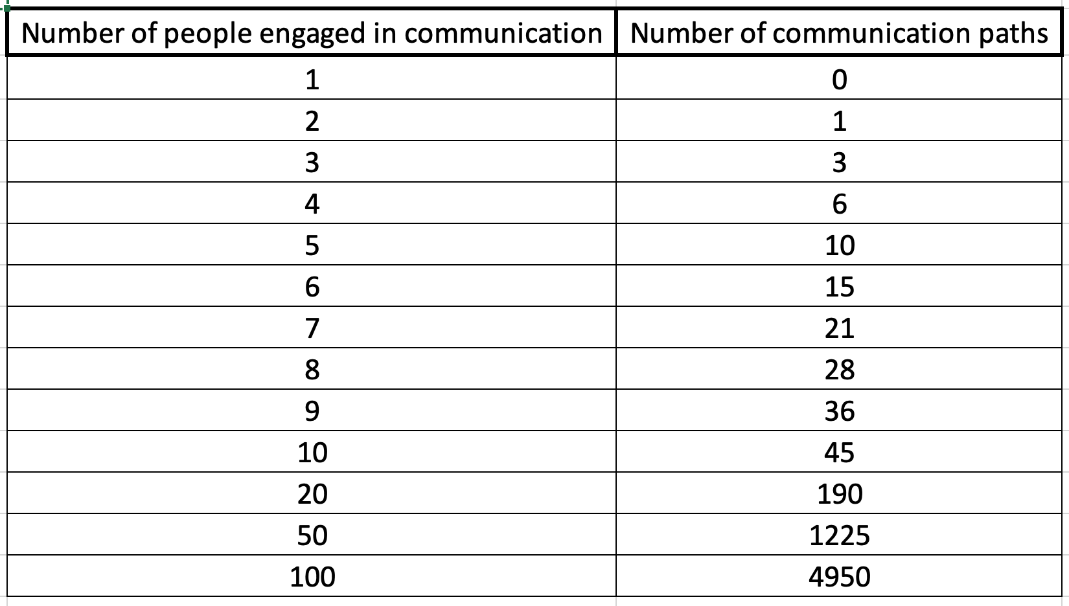
Number of communication paths (slide 1 of 2)
n(n-1)
Handshake formula=➔
2

Slide 44
Number of communication paths (slide 2 of 2)
Observations:
As the number of people engaged in a communication increases the number of potential interactions grows rapidly
If you don’t manage how these interactions take place, communication will get out of control quickly
The more people engaged in a communication, the more interactions, the more likely the message can be misinterpreted by someone.
As the number increases it is harder to make sure everyone is involved
n(n-1)
2
Comment: This is also called the “hand shake” formula.

Slide 45

6 things to never discuss at work: Travis Bradberry
That you are job hunting
Your political beliefs
How much money you make
That you hate your job
That you think someone is incompetent
https://www.theladders.com/career-advice/8-things-smart-people-never-reveal-about-themselves-at-work?vtmd=biYOBJZz/UZ4sFEiBieLmVbCe3I0%2B4JEAhADHIE%2Bm/YlgHe7zo3UG9RBKyqkqhw%2Bt4WXnz4AZ/a5Fg3rPePfAV2uy8A7kae/Ov2G72B5QRI%3D&utm_swu=6280&utm_campaign=daily-newsletter&utm_source=member&utm_content=9/13-DNL%20My%20Life%20FOR%20SEND%20AB&utm_medium=email&utm_term=DNL-9-13-19%20My%20Life%20FOR%20SEND%20AB

Slide 46

PMBOK ON CONFLICT P 349 (Project Resource Management Chapter)
Withdraw/avoid
Smooth/accommodate
Compromise/reconcile
Force/direct
Collaborate/problem solve

Slide 47

Harvard Business Review: How to disagree with your boss (slide 1 of 2)
Explain that you have a different opinion and ask if you can voice it.
Restate the original point of view or decision so it’s clear you understand it.
Speak slowly and calmly
State that you are adding your opinion because you support the best interests of the company
https://getpocket.com/explore/item/how-to-disagree-with-someone-more-powerful-than-you?utm_source=pocket-newtab

Slide 48
Harvard Business Review: How to disagree with your boss (slide 2 of 2)
Use facts as possible.
Don’t use judgement words like “hasty,” “foolish,” etc.
Have an alternative ready

Slide 49
Ethos, Pathos, Logos: building credibility
Ethos is a Greek word meaning "character" that is used to describe the guiding beliefs or ideals of the communicator*
Pathos when a communicator appeals to the emotions of the audience and elicits feelings that already reside in them.*
Logos when a communicator appeals to logic
*Source = Wikipedia

Slide 50
When you need something do not use “ASAP”
”ASAP” is an acronym that stands for as soon as possible
It means different things to different people
Always provide an exact date by which you need something
The date can act like a trigger event to reach out to someone who is not responding (e.g. I asked for the document on October 1, and I never received it.)

Slide 51
“What’s In It For Me” (A.K.A., WIIFM)
You are making an attempt to tell the receiver of your message why the communication is important from their perspective.
The idea is that by having people understand why it is important to them, they are more likely to take the action you want them to take.

Slide 52
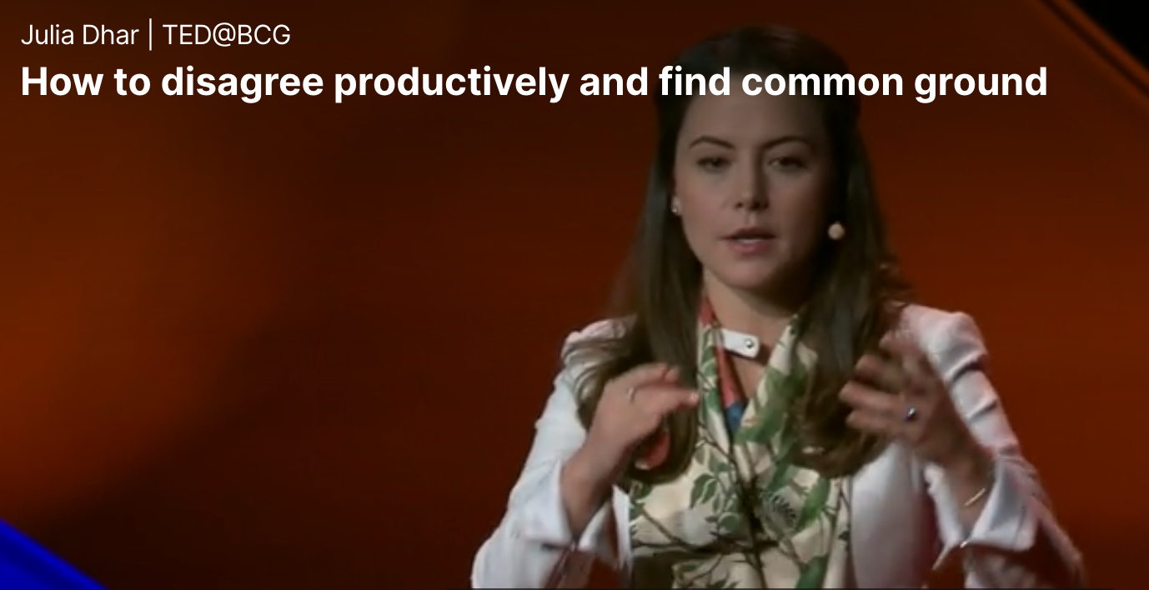
TED on conflict 2.6 M Views/14.56 Min
Debate requires that we engage with the conflicting idea, directly, respectfully…
The foundation of debate is rebuttal.
People who disagree the most productively start by finding common ground
http://bit.ly/2JMDWay

Slide 53
TED talk on debate questions
Why is “directly” confronting the issues important?
What is a “shared reality?”
What starts the beginning of a “shared reality?”
“Your only winning strategy is to engage with the best, clearest, least personal version of the idea. ” Why is engaging with the “least personal” approach so important?
Why does submitting “ideas anonymously” work?
What is “intellectual humility” and how can it help reduce conflict?

Slide 54
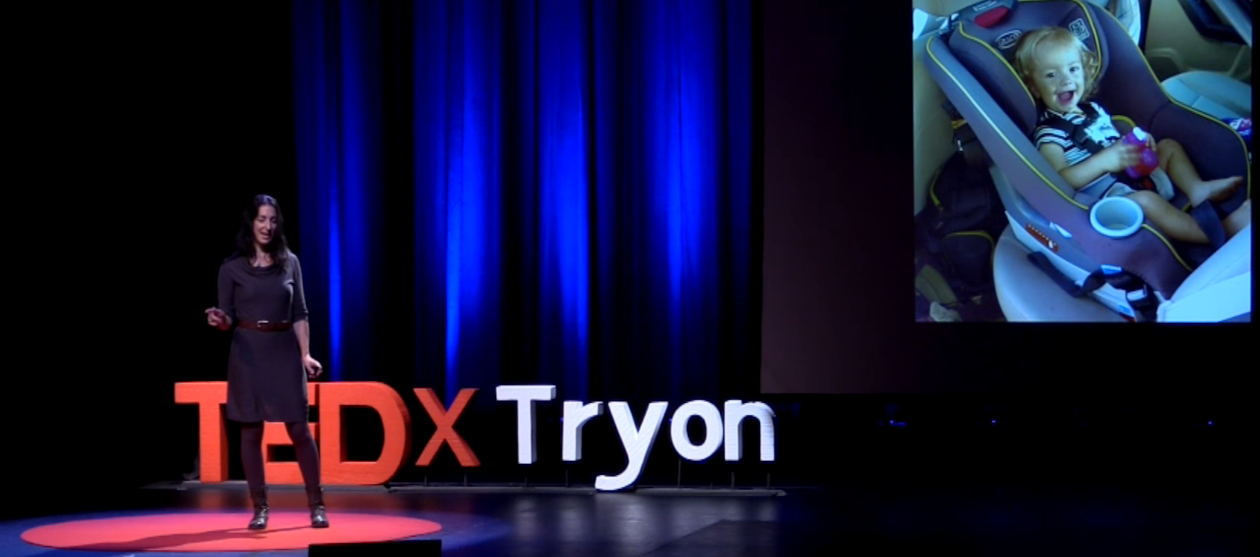
TED Talk: “How Understanding Conflict Can Help Improve Our Lives” 27 K views 12 min
Starting a presentation with a story is a very powerful technique. What was her story?
Conflict lies in:
“Limited Resources”
”Unmet Needs”
“Different Values”
https://www.youtube.com/watch?v=fdDQSHyyUic&t=343s

Slide 55
TED Talk: “How Understanding Conflict Can Help Improve Our Lives” 12 min
What is the difference between a “need” vs. a “want?” How will being able to separate out these two items make negotiations easier?
Do emotions get in the way of logical thinking?
What is empathy, what does it have to do with understanding emotions, and, why does displaying true empathy establish a good foundation for conflict resolution?
What are some good techniques to move a person from emotional thinking to logical thinking?

Slide 56
End Communications Management Knowledge Area

